Slide 1
Data Analyst Nanodegree
Session 1
Conducted by: Hamza
Notes:
https://udacity.zoom.us/j/7991233356
<number>

Slide 2
Slack / SUPPORT / REPOs
https://join.slack.com/t/egfwd-t3-march-22/shared_invite/zt-146jjry1h-VrWow3RuYnZ1bk~ZUyrPzg
fwd-support@udacity.com
https://github.com/santarabantoosoo/Data-Analysis-NanoDegree-2.0
Notes:
<number>

Slide 3



Slide 4



Slide 5



Slide 6
agenda
Orientation
Resources
Data analysis Vs data science Vs ML Vs statistics
Project
Breakout room

Slide 7
Points to consider
Connect session same time same day
Revoking
Better come prepared
Plagiarism
Notes:
<number>

Slide 8






Getting started
https://www.udacity.com/bertelsmann-tech-scholarships
Links?
Notes:
Ask questions
Answer questions
Post resources
Share ideas of projects and ask for collaborators
Share life hacks
Share job opportunities
<number>

Slide 9
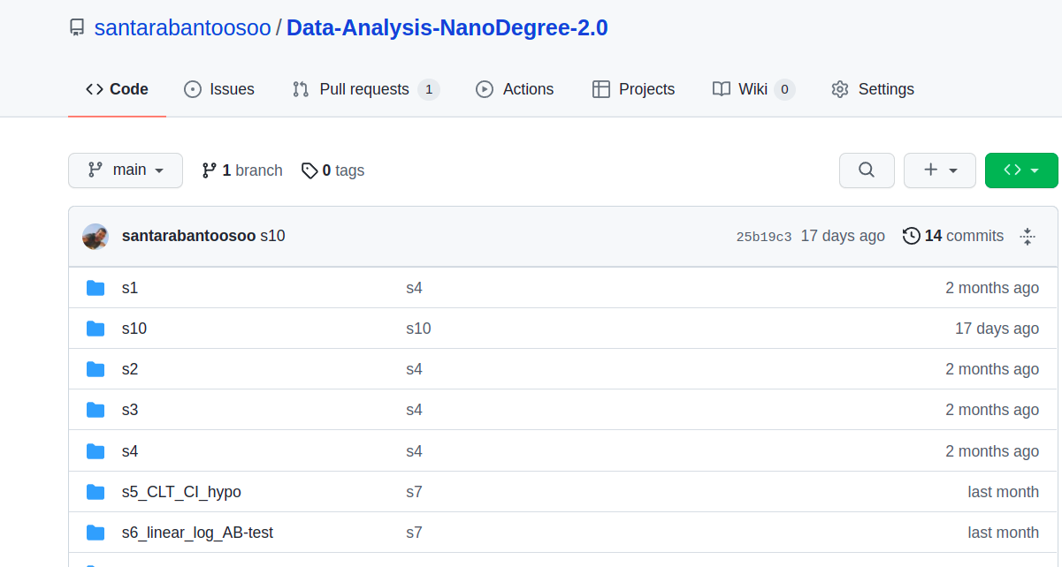
Github demo

Slide 10

Github demo

Slide 11
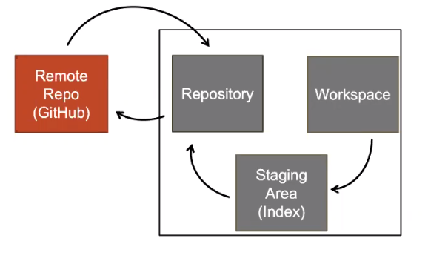
Git Flow

Slide 12
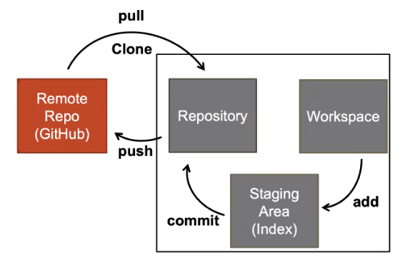
Git Flow

Slide 13
Breakout rooms
Leaders
Responsibilities:
Share screen
Reporting progress to me
troubleshooting
Benefits:
First to get access to datacamp
Higher chance for a udacity recommendation
https://docs.google.com/spreadsheets/d/192R3DWLjUJU80XYr9_qubNvc1NXZuP8GPh9TyvMPa1c/edit#gid=0

Slide 14
Breakout rooms
current task:
Personal info
Github account
Add at least one collaborator
https://docs.google.com/spreadsheets/d/192R3DWLjUJU80XYr9_qubNvc1NXZuP8GPh9TyvMPa1c/edit#gid=0

Slide 15


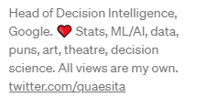

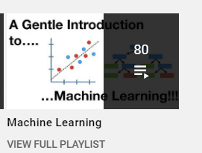
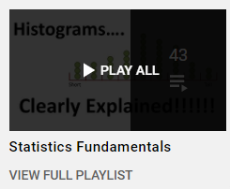

خد فكرة
Notes:
<number>

Slide 16

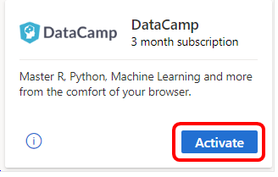
Github student developer pack
Notes:
<number>

Slide 17

Pop quiz
والجوائز ايه يا أستاذ ؟

Slide 18

complete
الخناقة كانت على 10 متر سيراميك ..

Slide 19
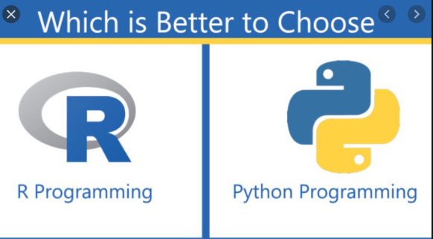

العركة

Slide 20
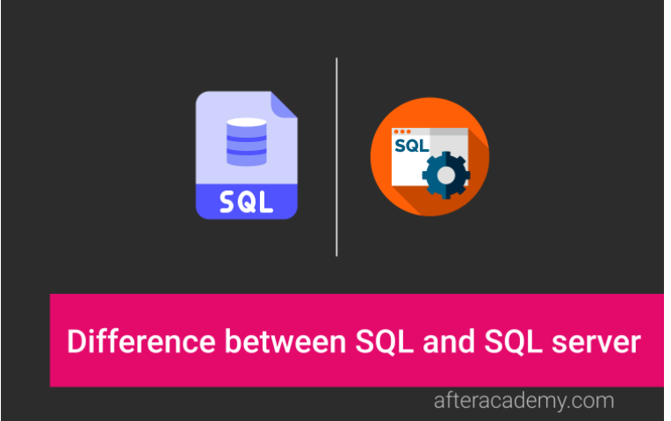
Difference?
Notes:
SQL Server = MS SQL
It is to be noted that the queries can only be written using SQL, but we need some RDBMS(Relational Database Management Systems) like SQL Server, Oracle to execute those SQL commands and queries.
What is the difference between SQL and SQL server?
https://afteracademy.com/blog/what-is-the-difference-between-sql-and-sql-server
<number>

Slide 21
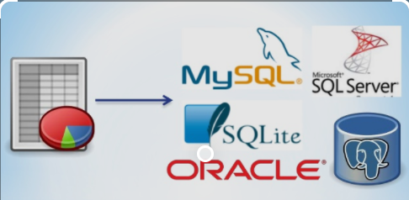
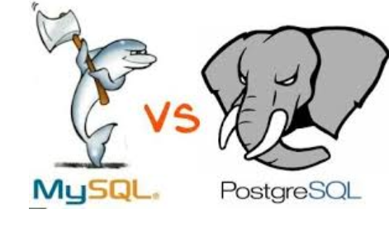
Relational db management systems
Notes:
<number>

Slide 22
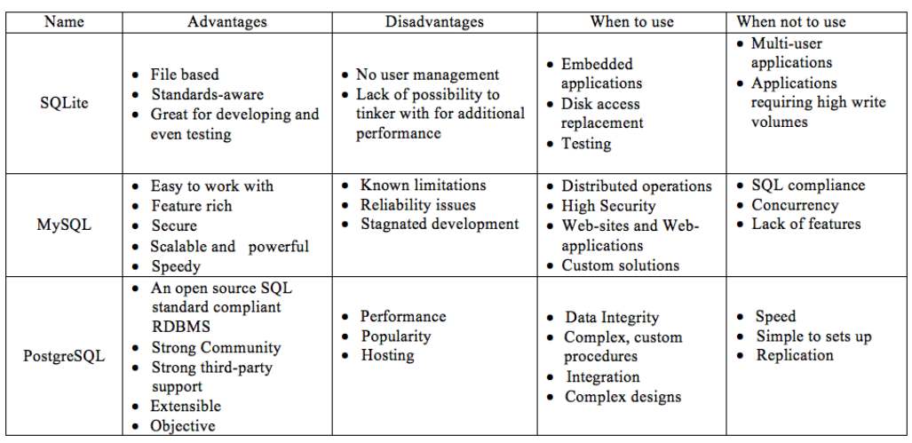
Notes:
SQLite vs MySQL vs PostgreSQL: A Comparison Of Relational Database Management Systems | by Yang Wang | Medium
https://medium.com/@yangforbig/sqlite-vs-mysql-vs-postgresql-a-comparison-of-relational-database-management-systems-afd5afd6566
SQLite vs MySQL vs PostgreSQL: A Comparison Of Relational Database Management Systems | DigitalOcean
https://www.digitalocean.com/community/tutorials/sqlite-vs-mysql-vs-postgresql-a-comparison-of-relational-database-management-systems
<number>

Slide 23
العركة

Slide 24

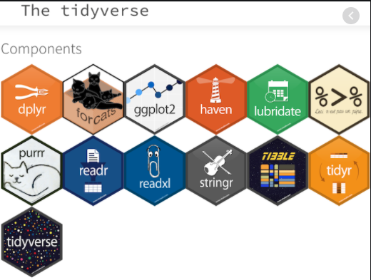


Slide 25
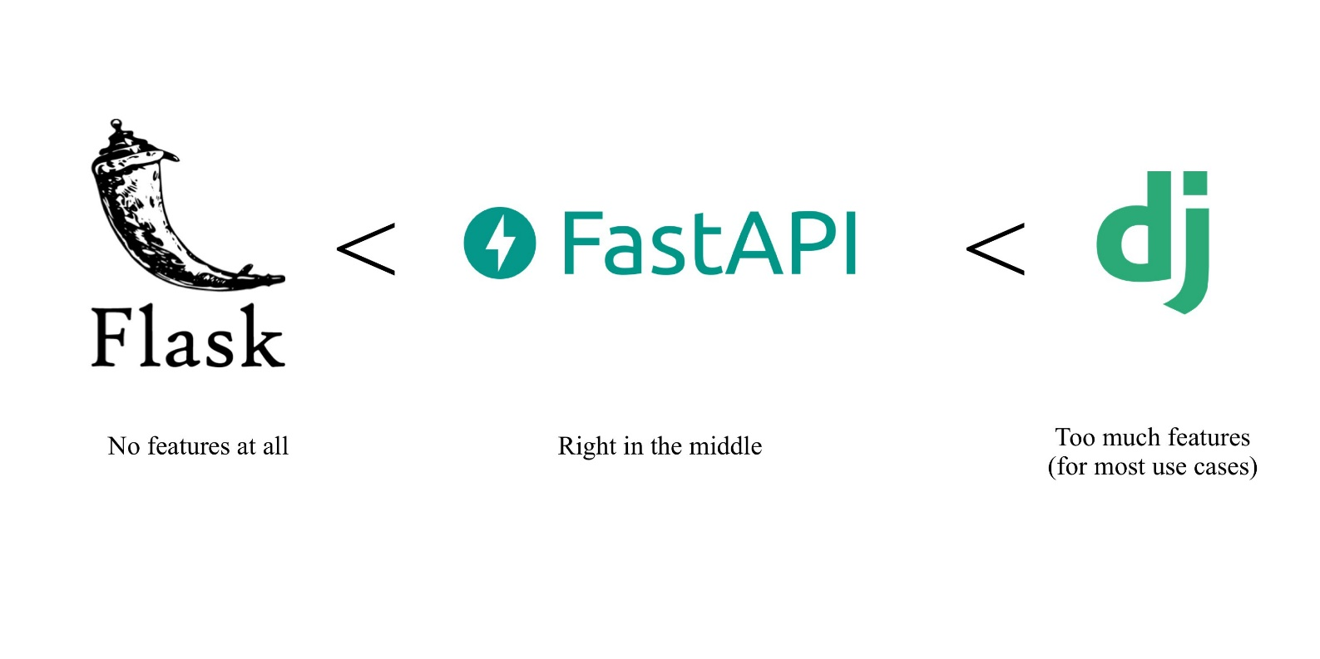
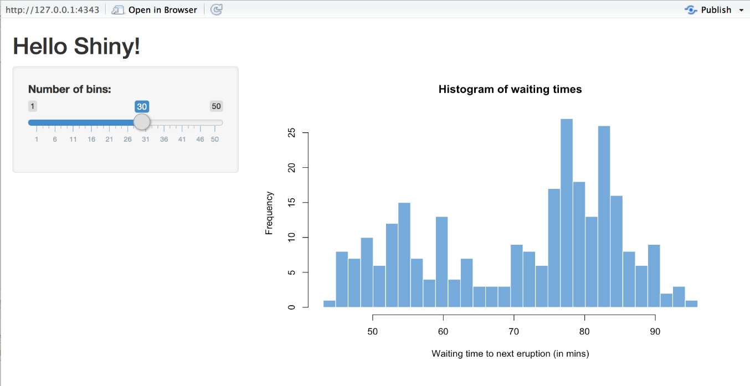


Slide 26



Machine learning

Slide 27

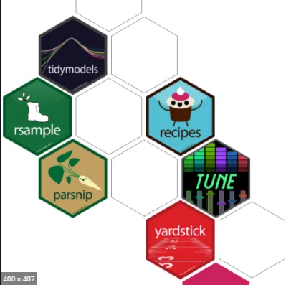

Think again?

Slide 28



Deep learning
Notes:
<number>

Slide 29

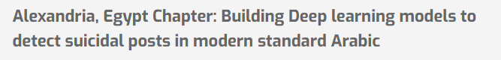
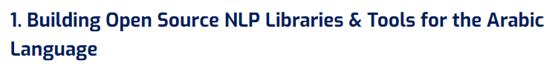
Omdena
Notes:
Omdena Egypt Chapter - Omdena Chapters
https://omdena.com/omdena-chapter-page-egypt/
<number>

Slide 30

Good Opporunity
Translating English data science articles to Arabic using transformers models
Notes:
Omdena Egypt Chapter - Omdena Chapters
https://omdena.com/omdena-chapter-page-egypt/
<number>

Slide 31

Python only? Sql ?? R??

Slide 32

Think again

Slide 33

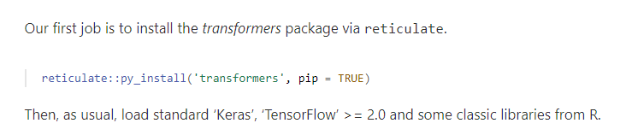
Notes:
RStudio AI Blog: State-of-the-art NLP models from R
https://blogs.rstudio.com/ai/posts/2020-07-30-state-of-the-art-nlp-models-from-r/
<number>

Slide 34
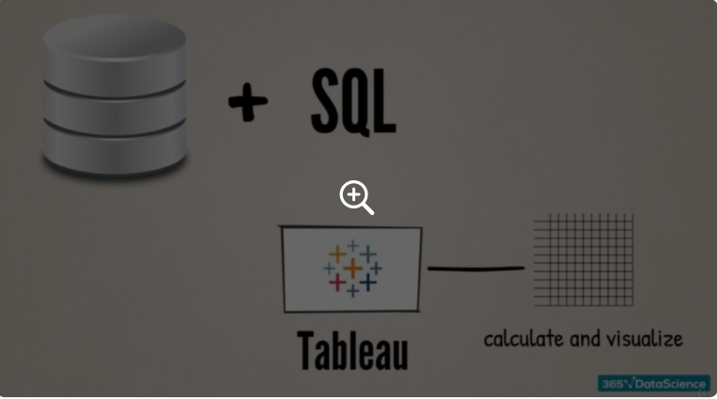
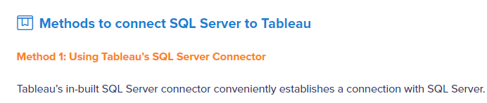
Sql + tableau
Notes:
Integrating SQL and Tableau | 365 Data Science
https://365datascience.com/tutorials/sql-tutorials/integrating-sql-tableau/
<number>

Slide 35

SQL to python

Slide 36
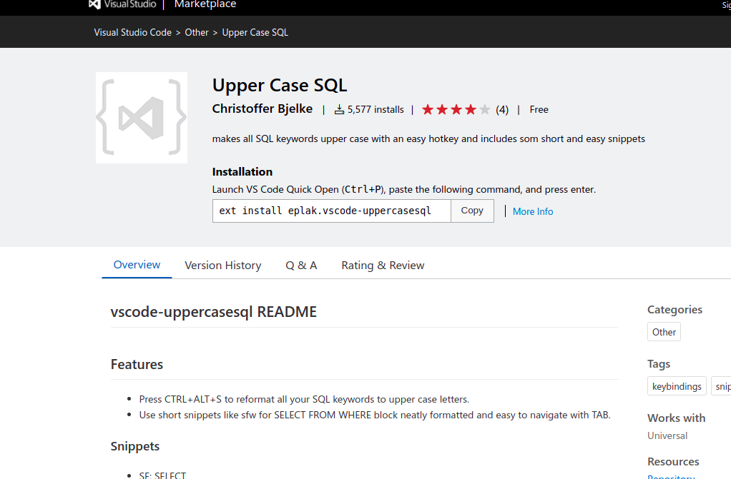
SQL extensions

Slide 37
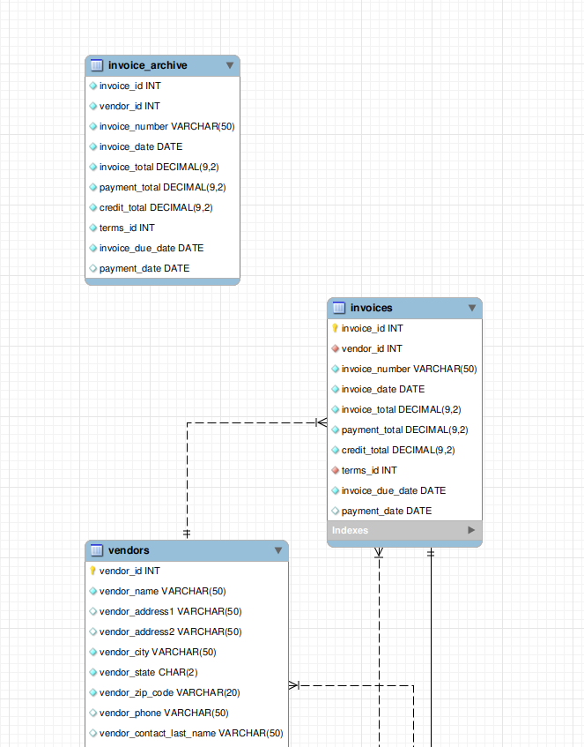
ER diagram
How to create using mysql workbench?
https://dataedo.com/kb/tools/mysql-workbench/create-database-diagram

Slide 38

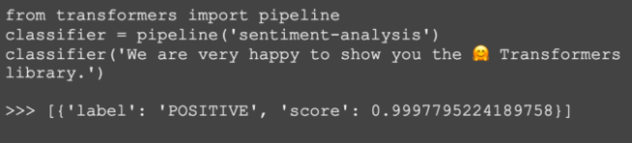
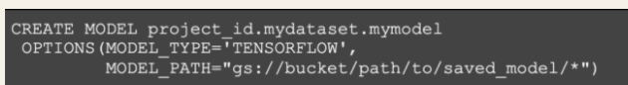
Sql + deep learning

Slide 39
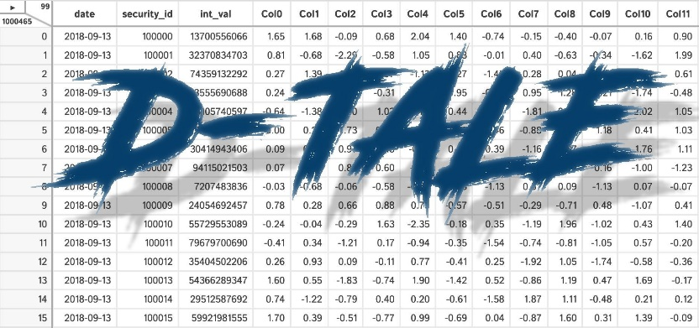

Bottom line?
1. Start
2. SEARCH – KEEP UPDATED!
Notes:
It doesn’t really matter. U can use any.
<number>

Slide 40
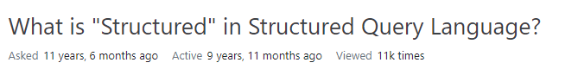
Why called structured?
SEQUEL
Notes:
sql - What is "Structured" in Structured Query Language? - Stack Overflow
https://stackoverflow.com/questions/2938908/what-is-structured-in-structured-query-language
<number>

Slide 41
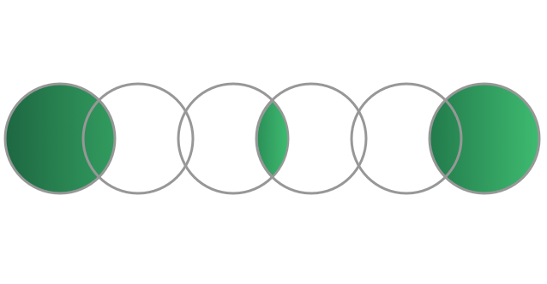
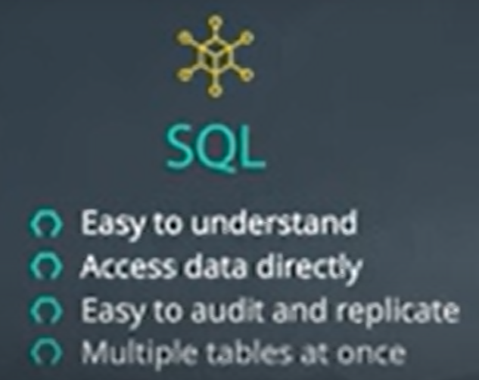
sql
Why is SQL important? If we can use R/PYTHON?
Notes:
Huge tables – joined – without being loaded
If it can be replaced by other software?
SQL is easy to understand.
Traditional databases allow us to access data directly.
Traditional databases allow us to audit and replicate our data.
SQL is a great tool for analyzing multiple tables at once.
SQL allows you to analyze more complex questions than dashboard tools like Google Analytics.
SQL vs python
Access data directly I think
<number>

Slide 42
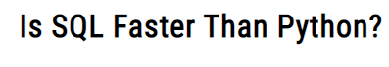

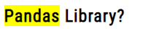
What about speed?
Notes:
Is SQL Faster Than Python? The Answer May Surprise You – Data Science Nerd
https://datasciencenerd.com/is-sql-faster-than-python/
<number>

Slide 43

Sql refreshment

Slide 44
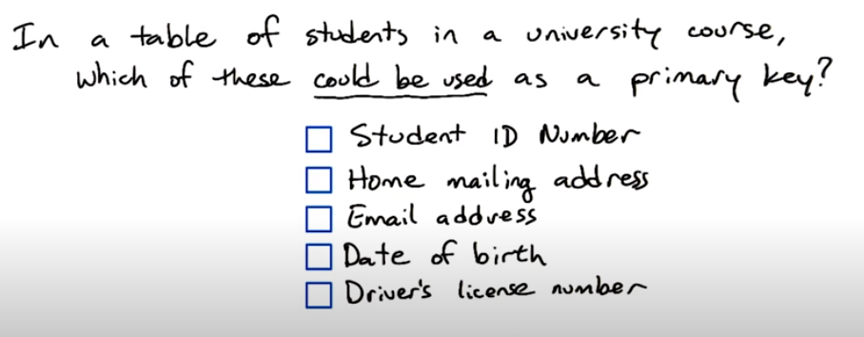
Primary key
Notes:
Mailing address : sharing the same house
Email address : ok but maybe it is changed one day
DOB: maybe unique but a primary key has to be unique
Driver’s license No: some students don’t drive
<number>

Slide 45
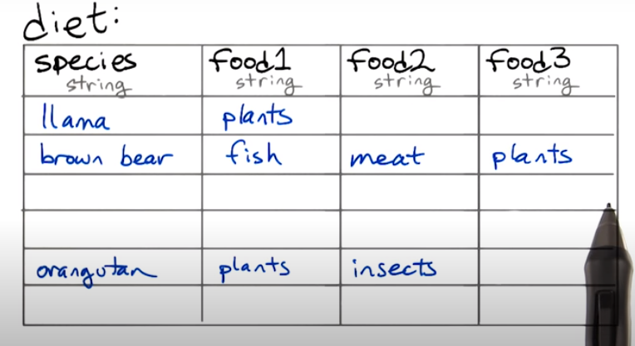
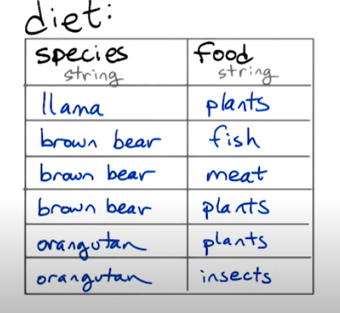
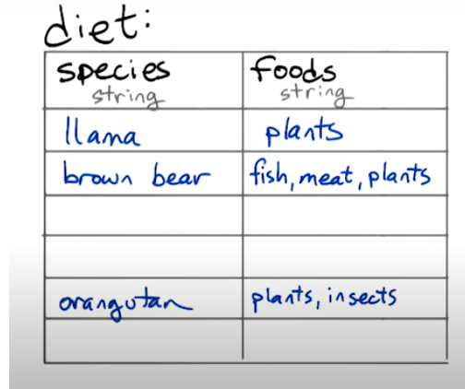
queries
Notes:
The left table works better with joins, with aggregations and you don’t need to know the different types of food in advance.
In addition, no missing data
<number>

Slide 46
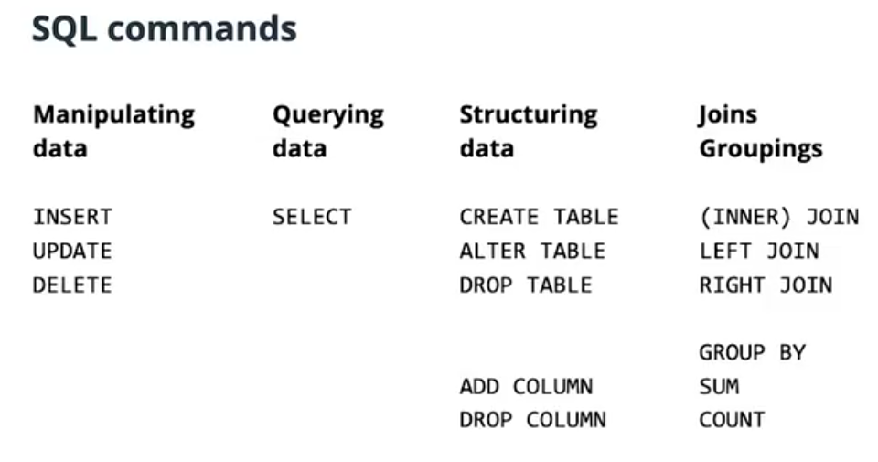
Notes:
PowerPoint Presentation
https://www.postgresqltutorial.com/wp-content/uploads/2018/03/PostgreSQL-Cheat-Sheet.pdf
<number>

Slide 47
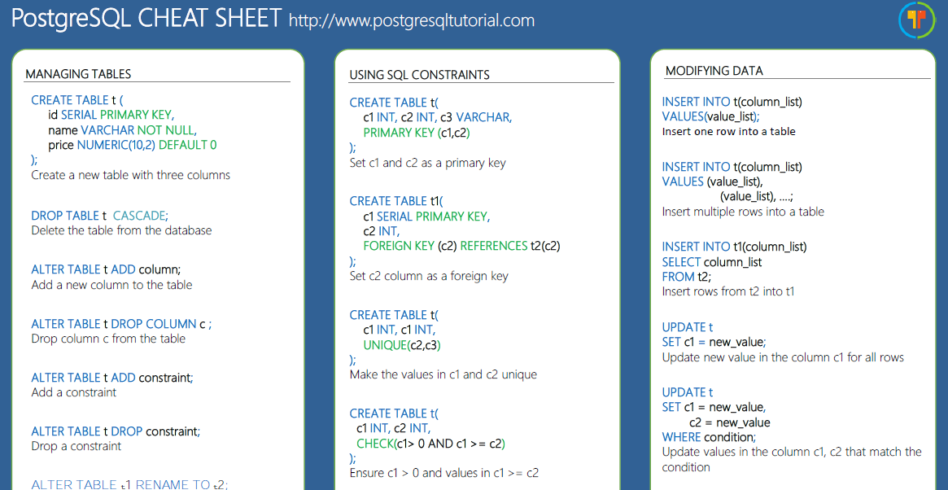
CHEAT SHEET
https://www.postgresqltutorial.com/postgresql-cheat-sheet/

Slide 48

foffa

Slide 49
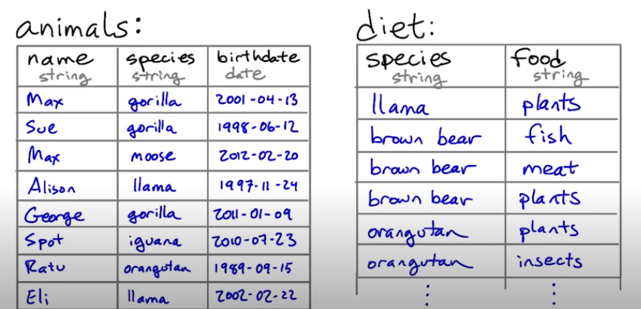
join
Select animals that eat fish

Slide 50
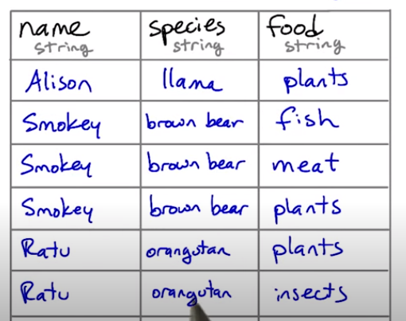
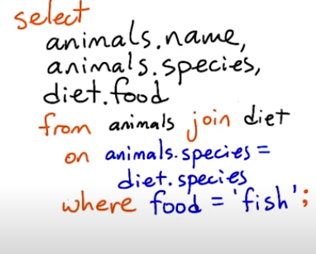
Generate the new table

Slide 51
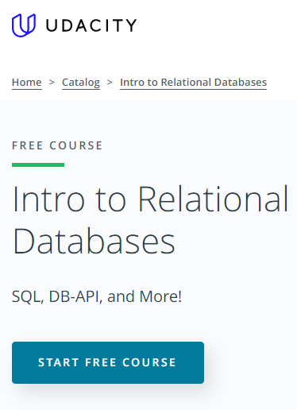
Notes:
[Intro to Relational database](https://www.udacity.com/course/intro-to-relational-databases--ud197)
<number>

Slide 52
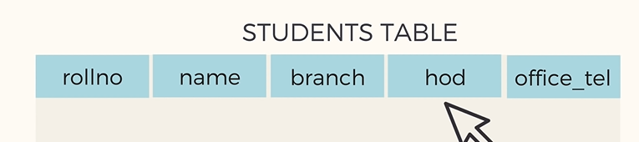
What’s the problem?
Notes:
Hod: head of department
<number>

Slide 53
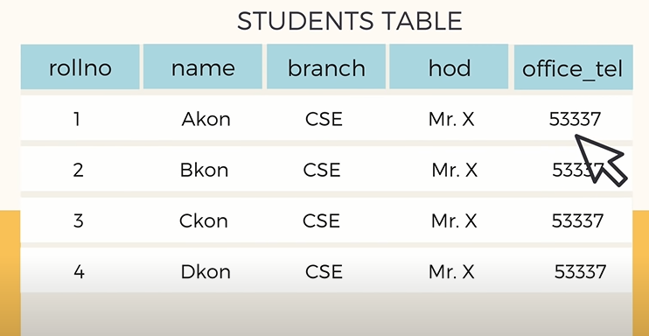
Apart from redundancy, are there any other problems?

Slide 54
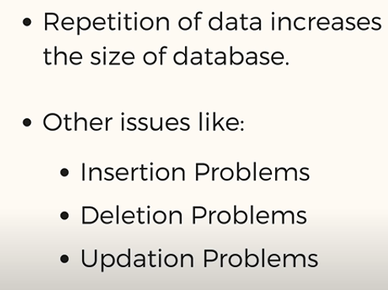
Problem?
Apart from redundancy, are there any other problems?

Slide 55
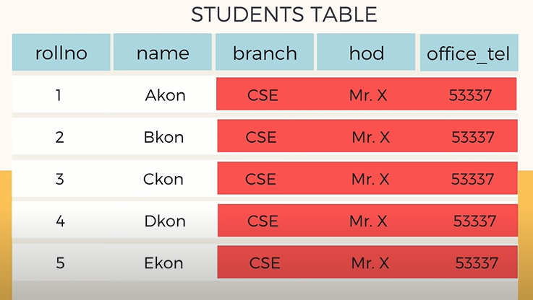


Insertion anomaly
What if we want to add 100 students?
Notes:
<number>

Slide 56
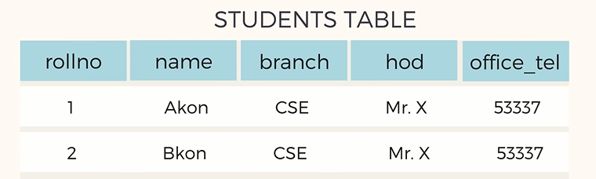
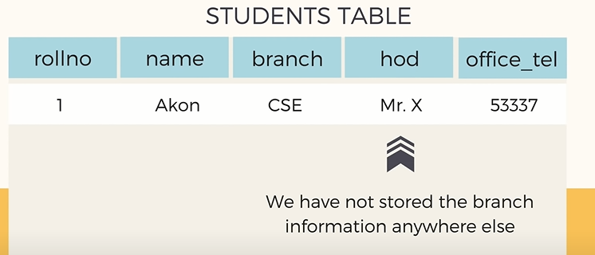

Deletion anomaly

Slide 57
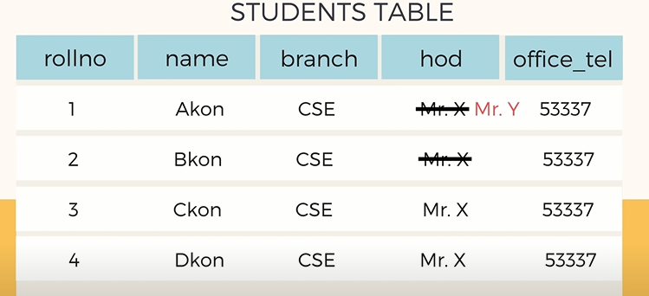
modification anomaly

Slide 58
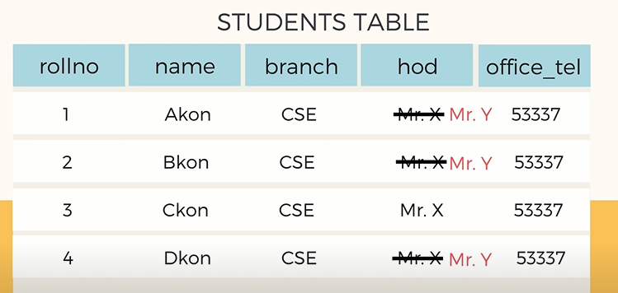
Do for all and never miss
How to solve?
Notes:
If one is missed, there will be inconsistencies
<number>

Slide 59
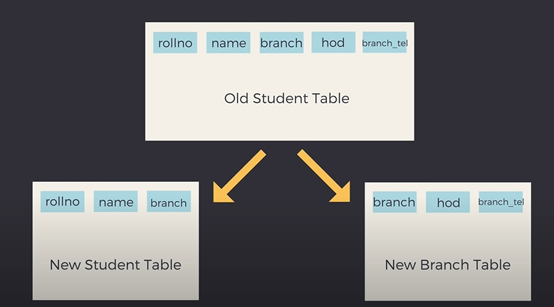
solution

Slide 60

Eliminate redundancy?
Notes:
One can say that there is still redundancy
Normalization is about minimizing redundancy not eliminating it.
<number>

Slide 61

Insert, Update & delete now?
Notes:
Automatically updated for all students’ records
<number>

Slide 62

Deletion solved

Slide 63

More info
Notes:
Basic Concept of Database Normalization - Simple Explanation for Beginners - YouTube
https://www.youtube.com/watch?v=xoTyrdT9SZI
<number>

Slide 64
Rules of normalization
unique primary key
Non-key relate to primary key
Non-key don’t relate to each others.
More rules ...

Slide 65



Export to database

Slide 66



Importing from a database

Slide 67

أفضل سيناريو

Slide 68

Data science
Statistics
Data science
Exploratory data analysis
Data analytics
What and why?
Notes:
<number>

Slide 69

Data science
Make data useful

Slide 70

العركة؟
What’s the difference?

Slide 71
Analytics vs stats vs ML?
Notes:
The SQL vs R vs Python taxonomy is ill-advised for so many reasons, not least of which is that software evolves. (As of recently, you can even do ML in SQL.) Wouldn’t you prefer a breakdown that’ll last?
by the algorithm (surprise! it’s how university courses are structured). Pretty please, don’t taxonomize by histograms vs t-tests vs neural networks. Frankly, if you’re clever and you have a point to make, you can use the same algorithm for any part of data science. It might look like Frankenstein’s monster, but I assure you it can be forced to do your bidding.
<number>

Slide 72
Make data useful

Slide 73
العركة؟
What’s the difference?

Slide 74



Analytics vs (statistics/AI/ML/DP)

Slide 75

What u see?

Slide 76


What u see, again?
12 sec shake?
Notes:
Satellite photo of the “Face on Mars” which many people took as evidence of extraterrestrial habitation.
How to know if there is indeed life on Mars? Test
How to know if 12 sec shake of ink can give u a butterfly image?
Retry
<number>

Slide 77



Slide 78
Analytics vs (statistics/AI/ML/DP)

Slide 79


Slide 80






Data analytics
Notes:
The great news is that this one is easy. Think of your dataset as a bunch of negatives you found in a darkroom. Data-mining is about working the equipment to expose all the images as quickly as possible so you can see whether there’s anything inspiring on them. As with photos, remember not to take what you see too seriously. You didn’t take the photos, so you don’t know much about what’s off-screen. The golden rule of data-mining is: stick to what is here. Only make conclusions about what you can see, never about what you can’t see (for that you need statistics and lot more expertise).
<number>

Slide 81

want more?
Notes:
What on earth is data science?. The quest for a useful definition | by Cassie Kozyrkov | HackerNoon.com | Medium
https://medium.com/hackernoon/what-on-earth-is-data-science-eb1237d8cb37
<number>

Slide 82






Slide 83

Data driven
Notes:
For a decision to be data-driven, it has to be the data — as opposed to something else entirely — that drive it. Seems so straightforward, and yet it’s so rare in practice because decision-makers lack a key psychological habit.
العربية الكارو محتاجة حمار عشان تبقى كارو
<number>

Slide 84

scenario
Notes:
Imagine that you are considering buying something online instead of making a pilgrimage to the other side of town to fetch it. You’ve boiled your decision down to whether or not you trust the online seller. A quick search yields some relevant data: you see that the seller has an average rating of 4.2 out of 5.
<number>

Slide 85

What u think?
Notes:
Now you can’t use that 4.2 to drive your decision. Game over! Once we’ve seen the answer, we’re free to pick the most convenient question. If the first thing we do is poke around in our data, our decision will be, at best, something I like to call data-inspired.
<number>

Slide 86

Data-drivenness destroyed
Any idea why?
Notes:
Once we’ve seen the answer, we’re free to pick the most convenient question
<number>

Slide 87
Data-drivenness destroyed
Once we’ve seen the
answer, we’re free to pick
the most convenient
question
Notes:
<number>

Slide 88


Notes:
That’s where we, like whales encountering plankton, swim around in some numbers, and then reach an emotional tipping point and… decide. There are numbers near our decision somewhere, but those numbers don’t drive it. The decision comes from somewhere else entirely.
<number>

Slide 89

Notes:
<number>

Slide 90

Notes:
The decision-maker’s mind was made up before the data, so the decision was there all along. Turns out humans interact with data selectively to confirm choices we’ve already made in our heart of hearts. We find the most convenient light in which to see evidence, and we don’t always know we’re doing it. Psychologists have a lovely name for this: confirmation bias.
<number>

Slide 91
Is it good?
Notes:
Positive
“It’s more than 4.0!”
They can even show a rigorous analysis about how it is statistically significantly higher than 4.0. (With certainty! It’s the p-value you’ve always wanted.)
Negative
“Why would I settle for a seller with less than 4.5 stars?” Or perhaps “But look at those 1-star reviews. I don’t like how many there are.” Sound familiar?
<number>

Slide 92


Slide 93

Solution
Notes:
Mathematical complexity doesn’t provide the antidote, it merely makes it harder to see the problem. As a result, what’s obvious in the trivial example we just saw becomes hidden in a jumble of gorgeous Gaussians. Don’t assume your friendly neighborhood data scientist sees it either. The more ways there are to slice the data, the more your analysis is a breeding ground for confirmation bias.
<number>

Slide 94

But why?

Slide 95

Notes:
feel better about doing what they were going to do anyway.
<number>

Slide 96


Any problem with real projects?
Notes:
It’s all about rating
What about a real pro
<number>

Slide 97



Expensive hobby

Slide 98

What’s the decision?
للأستاذة شيرين عبد الوهاب
Notes:
<number>

Slide 99

Notes:
When decision-makers lack fundamental skills, there’s no math in the world that can fix it. Your data science team will not contribute to data-driven decision-making.
<number>

Slide 100

What if?
Notes:
nothing would be different if all those poor data scientists just made some numbers up
<number>

Slide 101


Cassie advice
Notes:
Data scientist friends, if your organization suffers from this kind of decision-maker, then I suggest sticking to the most lightweight and simple analyses to save time and money. Until the decision-makers are better trained, your showy mathematical jiu jitsu is producing nothing but dissipated heat.
<number>

Slide 102


Slide 103

Problem
How to solve?
Notes:
Problem: you’re free to move the goalposts after you find out where the data landed. (Of course you score a goal every time. You’re just that good.)
<number>

Slide 104


Solution
Notes:
set the goalposts in advance and resist temptation to move them later.
Framing the decision and setting decision criteria is a science of its own
a quick fix that goes a long way is to come up with your decision boundary up front in your data science project.
resis
<number>

Slide 105

Practice
How to set goal first?

Slide 106

Solution
Notes:
she tugs at the pricetag on the back. “Hey, what does this say?” she asks me. “If it’s less than 80 bucks, I’ll buy it.”
<number>

Slide 107

Order matters
Notes:
Now that’s some decision intelligence! Instead of first seeing the price and then talking herself into a decision she’s already made, she uses the data to drive it. With a well-practiced reflex, she weighs how much she likes the dress and her budget, then sets the decision boundary, and only allows herself to see the data (price) once that’s done. She’s in the habit of using data in the right order and that’s a muscle you can exercise too.
<number>

Slide 108

Practice your data driven muscle
Notes:
People don’t always need to be data-driven and Emma knows that. She doesn’t have to make unimportant decisions that way, but she also knows that practice makes perfect. It’s much easier to build the habit on trivial decisions than to struggle when the important ones come around.
<number>

Slide 109

Negotiation 101
Notes:
I went to buy fireworks
I sticked to 80 pounds
<number>

Slide 110

What if I didn’t ?

Slide 111

Notes:
In fact, standard advice for negotiators is to think through the entire range of potential offer combinations and plan your reactions to them in advance, otherwise it’s very easy for an experienced opponent to take advantage of you. Even without all the persuasion tactics at your counterpart’s disposal, irrelevant short-term factors like your blood sugar levels, your mood, how much the other party is smiling, and whether the sun is shining can have a disproportionate effect on the deal.
<number>

Slide 112


Apply for a job
Notes:
Next time you’re negotiating a salary, for example, make sure you’ve thought about your number before you hear theirs.
Whether you think about what a number means to you before or after you see it, you still have to think about it. Doing it beforehand helps you counter some of the bugs in your human programming, with large payoffs in decision quality and negotiation performance. Improving the order of operations here is a valuable habit to cultivate and crucial if you’d like to be involved in data-driven decision-making. And here’s some bonus good news: with practice it’ll feel automatic.
<number>

Slide 113


Notes:
Data-Driven? Think again. The psychological habit most people… | by Cassie Kozyrkov | HackerNoon.com | Medium
https://medium.com/hackernoon/data-inspired-5c78db3999b2
<number>

Slide 114

project

Slide 115

Pandas
Axis
Minimally sufficient pandas
plotting

Slide 116

axis

Slide 117

Axis = 0
Axis = 1
Axis = ‘rows’
Axis = ‘index’
Axis = ‘columns’
Notes:
What do they mean?
<number>

Slide 118

Series
Notes:
Python for Machine Learning: Pandas Axis Explained | Railsware Blog
https://railsware.com/blog/python-for-machine-learning-pandas-axis-explained/
Usually, in Python, one-dimensional structures are displayed as a row of values. On the contrary, here we see that Series is displayed as a column of values.
<number>

Slide 119

dataframe
Notes:
Our DataFrame object has 0, 1, 2, 3, 4 indexes along the “axis 0”, and additionally, it has “axis 1” indexes which are: ‘a’ and ‘b’.
<number>

Slide 120

What’s the output?

Slide 121

No difference [single axis]

Slide 122


What’s the output?

Slide 123


Solution
Notes:
We see, that having sum with axis=0 smashed all values along the direction of the “axis 0” and left only columns(‘a’ and ‘b’) with appropriate sums.
<number>

Slide 124

Other solution
Notes:
If you prefer regular names instead of numbers, each axis has a string alias. “axis 0” has two aliases: ‘index’ and ‘rows’. “axis 1” has only one: ‘columns’. You can use these aliases instead of numbers:
<number>

Slide 125


Dropping NaN values
What to expect?
Notes:
<number>

Slide 126


Solution
Notes:
Now .dropna collapsed “axis 1” and removed all columns with NaN values. Columns ‘a’ and ‘b’ contained NaN values, thus only ‘c’ column was left.
<number>

Slide 127



Concatenation
Output?

Slide 128


Concatenation
Notes:
Pandas borrowed the “axis” concept from NumPy library. The “axis” parameter does not have any influence on a Series object because it has only one axis
<number>

Slide 129



Slide 130


Slide 131


Notes:
My objective is to argue that only a small subset of the library is sufficient to complete nearly all of the data analysis tasks that one will encounter.
Minimally Sufficient Pandas. In this article, I will offer an… | by Ted Petrou | Dunder Data | Medium
https://medium.com/dunder-data/minimally-sufficient-pandas-a8e67f2a2428
<number>

Slide 132

Aim
Notes:
Know why limiting Pandas to a small subset will keep your focus on the actual data analysis and not on the syntax
Have specific guidelines for taking a single approach to completing a variety of common data analysis tasks with Pandas
<number>

Slide 133

Minimally Sufficient Pandas
Have almost everything
Analysis not syntax
Notes:
It is a small subset of the library that is sufficient to accomplish nearly everything that it has to offer.
It allows you to focus on doing data analysis and not the syntax
Your code will be simple, explicit, straightforward, and boring
You will choose one obvious way to accomplish a task
You will use this obvious way every single time
You won’t have to retain as many commands in working memory
Your code will be easier to understand by others and by you
<number>

Slide 134


Standardizing common tasks
Notes:
Better collaboration
Lesser memorization
<number>

Slide 135


No Tricks
Notes:
Knowing many obscure Pandas tricks might impress your friends, but it doesn’t usually lead to good code
It can lead to long lines of code that are difficult to understand and may be harder to debug.
شوف ده وشوف ده
<number>

Slide 136


Let’s start
Notes:
The concrete examples were all derived by the following principle:
If a method does not provide any additional functionality over another method (i.e. its functionality is a subset of another) then it shouldn’t be used. Methods should only be considered if they have some additional, unique functionality.
Will koehrson
<number>

Slide 137


Selecting a Single Column of Data
Select state, color, fav food
and count
NB 2
Notes:
How to select state, color favorite food and count?
Notice that when selecting count, it states at the top ‘bound method DataFrame.count of’. Python is telling us that this is a method of some DataFrame object.
Also I can’t select fav food by dot notation
Will cover isA
<number>

Slide 138

The column name is a variable
Notes:
Failure
<number>

Slide 139

Autocompletion?

Slide 140

Notes:
Which AI Code Autocomplete Should You Choose? | The Startup
https://medium.com/swlh/kite-vs-tabnine-which-ai-code-autocomplete-should-you-choose-eb6eba85c3a6#:~:text=TabNine%20was%20released%20in%202019,Atom%2C%20Sublime%20Text%2C%20etc.
<number>

Slide 141

Notes:
<number>

Slide 142

How to select rows and columns?
ix
loc
iloc
at
Iat

Slide 143


ix indexer
Why was it deprecated?
Notes:
The ix indexer was created in the early days of Pandas to select rows and columns by both label and integer location.
This turned out to be quite ambiguous as Pandas row and column names can be both integers and strings.
<number>

Slide 144
Solution?
loc ➔ label
iloc ➔ integer location
Notes:
Deprecated : مهملة
Move to jupyter
<number>

Slide 145
How to select rows and columns?
ix
loc
iloc
at
iat

Slide 146

Selection with at and iat
Only a single cell
Notes:
select a single cell of a DataFrame
These provide a slight performance advantage over their analogous loc and ilocindexers. But, they introduce the additional burden of having to remember what they do. Also, for most data analyses, the increase in performance isn’t useful unless it’s being done at scale. And if performance truly is an issue, then taking your data out of a DataFrame and into a NumPy array will give you a large performance gain.
<number>

Slide 147
How to select rows and columns?
ix
loc
iloc
at
Iat
Notes:
The documentation uses the term position for referring to integer location. I do not like this terminology as I feel it is confusing. Integer location is more descriptive and is exactly what .iloc stands for.
python - pandas loc vs. iloc vs. at vs. iat? - Stack Overflow
https://stackoverflow.com/questions/28757389/pandas-loc-vs-iloc-vs-at-vs-iat
A perfect ans by Ankit Agrawal
<number>

Slide 148
Method Duplication
Which one to choose?
Notes:
The isna method was added more recently because the characters na are found in other missing value methods such as dropna and fillna. Confusingly, Pandas uses NaN, None, and NaT as missing value representations and not NA.
<number>

Slide 149

Method Duplication
Which one to choose?
Do we need notna?
Notes:
The isna method was added more recently because the characters na are found in other missing value methods such as dropna and fillna. Confusingly, Pandas uses NaN, None, and NaT as missing value representations and not NA.
There are aliases. Choose whichever u like
<number>

Slide 150

Solution
Notes:
You can also avoid ever using notna since Pandas provides the inversion operator, ~ to invert boolean DataFrames.
<number>

Slide 151



Builtin Python vs Pandas
Which one
To use?
NB 4
Notes:
<number>

Slide 152

Two datasets?
CONCAT
APPEND
JOIN
MERGE
Notes:
<number>

Slide 153

Two datasets

Slide 154

SQL?
NB Combining dataframes
Notes:
<number>

Slide 155


Ignore index
What to expect?
Notes:
<number>

Slide 156


Solution
Notes:
<number>

Slide 157

How to group and aggregate?
Notes:
finding the maximum SAT score per state
<number>

Slide 158



Guidance

Slide 159

Multiindex
How to?
How to remove?
Notes:
Relaffil = rel affiliation
A MultiIndex or multi-level index is a cumbersome addition to a Pandas DataFrame that occasionally makes data easier to view, but often makes it more difficult to manipulate. You usually encounter a MultiIndex after a call togroupby when using multiple grouping columns or multiple aggregating columns.
Here Both the rows and columns have a MultiIndex with two levels.
They have different syntax for making subset selections and are more difficult to use with other methods. If you are an expert Pandas user, you can get some performance gains when making subset selections,
<number>

Slide 160


Any difference?
Modify to
Get the
multiindex

Slide 161

Solution
How to revert
multilevel index?

Slide 162




Rename and reset
Rename columns
Reset index
Notes:
Guidance: Avoid using a MultiIndex. Flatten it after a call to groupby by renaming columns and resetting the index.
<number>

Slide 163

groupby vs pivot_table vs crosstab vs pivot

Slide 164



Which is which?
Wide vs
Long?
When to use?
Notes:
Groupby vs pivot_table
The wide format is the pivot table
Guidance: use pivot_table when comparing groups
I really like to use pivot tables to compare values across groups and a groupby when I want to continue an analysis. From above, it is easier to compare male to female salaries when using the output of pivot_table. The result is easier to digest as a human and its the type of data you will see in an article or blog post. I view pivot tables as a finished product.
The result of a groupby is going to be in tidy form, which lends itself to easier subsequent analysis, but isn’t as interpretable
<number>

Slide 165

Tidy
Notes:
Tidy Data | Wickham | Journal of Statistical Software
https://www.jstatsoft.org/article/view/v059i10
<number>

Slide 166

Similar?

Slide 167


pivot_table vs pd.crosstab
Notes:
The pivot_table method and the crosstab function can both produce the exact same results with the same shape. They both share the parameters index, columns, values, and aggfunc. The major difference on the surface is that crosstab is a function and not a DataFrame method.
<number>

Slide 168

How to get with pivot_table?

Slide 169

How to get with pivot_table?
What about cross_tab?
Notes:
<number>

Slide 170

With cross_tab

Slide 171

Want relative frequency?

Slide 172

Pretty easy
Notes:
You also have the option of normalizing over the rows using the string ‘index’ or over the entire DataFrame with the string ‘all’ as seen below.
<number>

Slide 173

Normalizing over rows or df
Notes:
You also have the option of normalizing over the rows using the string ‘index’ or over the entire DataFrame with the string ‘all’ as seen below.
<number>

Slide 174
Bottom line
Cross_tab easier for frequency
It seems that it can do everything
I think I can recommend it over pivot_table

Slide 175

Pivot vs pivot_table

Slide 176

No aggregation
Notes:
Using the pivot method, reshapes the data without aggregating or doing anything to it. pivot_table, on the other hand, requires that you do an aggregation
<number>

Slide 177


Pivot Pitfalls
Notes:
it can only handle the case when both index and columns are set to a single column. If you want to keep multiple columns in the index then you cannot use pivot. Also, if any combination of index and columns appear more than once, then you will get an error as it does not perform an aggregation.
pivot_table can accomplish all of what pivot can do. In the case that you do not need to perform an aggregation, you still must provide an aggregation function.
I think cross_tab is a better alternative
<number>

Slide 178


Melt vs stack
How to reshape?
Notes:
Let’s reshape this data so that we have three columns, the airline, the airport and the arrival delay
<number>

Slide 179
Using melt
What about stack??
Notes:
Let’s reshape this data so that we have three columns, the airline, the airport and the arrival delay
<number>

Slide 180



Using stack
Set index
Use stack

Slide 181
Compare melt/stack output
melt
stack
How to revert multi-index?
Notes:
This returns a Series with a MultiIndex with two levels.
<number>

Slide 182



Slide 183



Melt advantage
Notes:
Renaming on the fly
<number>

Slide 184
Do we need apply?
Consider discussing this
But after reading more about `
Notes:
Also see this Perfect post on stackoverflow
python - When should I (not) want to use pandas apply() in my code? - Stack Overflow
https://stackoverflow.com/questions/54432583/when-should-i-not-want-to-use-pandas-apply-in-my-code#:~:text=It%20is%20because%20apply%20is,major%20overhead%20at%20each%20iteration.
How and why to stop using pandas .apply() (so much) | by Sven Harris | Towards Data Science
https://towardsdatascience.com/avoiding-apply-ing-yourself-in-pandas-a6ade4569b7f
<number>

Slide 185

Apply vs map vs applymap
Notes:
Introduction to Pandas apply, applymap and map | by B. Chen | Towards Data Science
https://towardsdatascience.com/introduction-to-pandas-apply-applymap-and-map-5d3e044e93ff
<number>

Slide 186



Apply
Can we use lambda?

Slide 187

Apply

Slide 188


Apply
Can we use lambda?
Notes:
<number>

Slide 189

Apply

Slide 190

Notes:
applymap() is only available in DataFrame and used for element-wise operation across the whole DataFrame. It has been optimized and some cases work much faster than apply() , but it’s good to compare it with apply() before going for any heavier operation.
<number>

Slide 191



Slide 192

map

Slide 193



map
Notes:
map() is only available in Series and used for substituting each value in a Series with another value. To understand how the map() works, we first create a Series.
map() accepts a dict or a Series. Values that are not found in the dict are converted to NaN, unless the dict has a default value (e.g. defaultdict):
<number>

Slide 194

Notes:
To avoid applying the function to missing values (and keep them as NaN) na_action='ignore' can be used:
<number>

Slide 195












Best of the API
Notes:
<number>

Slide 196


Setting the scene
Notes:
d represents the weighted average of 50 Indian company stocks in 17 sectors. The dataset is openly available on Kaggle, but we’ll be using a subset of the data containing the stock value of only four sectors – banking, pharma, IT, and FMCG.
<number>

Slide 197



what to expect?
Notes:
Where is the x?
<number>

Slide 199

Solution
Notes:
Where is the x?
You will also need to specify the x and y coordinates to be referenced as the x and y-axis. Since the Date is already the index column, it will be configured as the X-axis.
<number>

Slide 200

Other options?
https://pandas.pydata.org/pandas-docs/stable/reference/api/pandas.DataFrame.plot.html

Slide 201


Slide 202

Bar plots
Can we use a bar plot?

Slide 203

Solution: group/aggregate
Can we draw bar charts for all 4 columns?
Notes:
data.resample() is used to resample the stock data.
The ‘M’ stands for month-end frequency and denotes the offset values you want to resample the data.
mean() indicates the average stock price during this period.
Is the average per month or the last day only?
<number>

Slide 204

How to convert to bar.. Multiple bars?
Notes:
<number>

Slide 205

Solution
Notes:
<number>

Slide 206

Similar solution
Notes:
<number>

Slide 207

How to get this?

Slide 208

Solution

Slide 209


Stacked?

Slide 210

What about horizontal stacked?

Slide 211
Correct ☺

Slide 212

Histograms vs bar plots?
Any differences?
Notes:
<number>

Slide 213

Axes needed?
Sure for bar graph?
Notes:
1 for hist
2 for bar
What about count plot?
<number>

Slide 214


Countplot
http://seaborn.pydata.org/examples/index.html
Also check their tutorial tab
Notes:
<number>

Slide 215

Histogram or bar plot?

Slide 216
Histogram or bar plot?
What does the code mean?
Notes:
The default bin value is 10. Bin size can be changed using the “bins” keyword.
Alpha sets the transparence
We selected only two columns
<number>

Slide 217

What to choose?

Slide 218
What to choose?
Notes:
<number>

Slide 219

Other options
Notes:
A hexagonal bin plot, also known as a hexbin plot, can be used as an alternative to scatterplots. This kind of plot is particularly useful when the number of data points is huge, and each point cannot be plotted individually.
<number>

Slide 220

https://neptune.ai/blog/pandas-plot-deep-dive-into-plotting-directly-with-pandas?utm_source=datacamp&utm_medium=post&utm_campaign=blog-pandas-plot-deep-dive-into-plotting-directly-with-pandas
Notes:
Pandas objects come equipped with their plotting functions. These plotting functions are essentially wrappers around the matplotlib library. Think of matplotlib as a backend for pandas plots.
5 Minute Guide to Plotting with Pandas | by Rebecca Vickery | Towards Data Science
https://towardsdatascience.com/5-minute-guide-to-plotting-with-pandas-e8c0f40a1df4
Fast plotting with Pandas. Quickly visualize your data with these… | by Tom Waterman | Towards Data Science
https://towardsdatascience.com/the-best-pandas-plotting-features-c9789e04a5a0
Data Visualization with Pandas and Seaborn 🎓 | by Tirendaz Academy | Level Up Coding
https://levelup.gitconnected.com/data-visualization-with-pandas-and-seaborn-5de444b567a0
08.Pandas Visualization | jupyter notebooks gallery
https://notebook.community/vravishankar/Jupyter-Books/pandas/08.Pandas%20Visualization
Python for Librarians: Plotting Your Data - Pandas
https://librarycarpentry.org/library-python/06a-plotting-with-pandas/
5.0
https://phdphysics.cloud.ba.infn.it/wp-content/uploads/2017/06/8-Diacono-3Maggio.pdf
Univariate plots in pandas | Python
https://campus.datacamp.com/courses/python-for-r-users/plotting-4?ex=2
Pandas Foundations | DataCamp
https://learn.datacamp.com/courses/pandas-foundations?tap_a=5644-dce66f&tap_s=93618-a68c98
Data Science Courses: R & Python Analysis Tutorials | DataCamp
https://learn.datacamp.com/search?q=pandas+plot
Pandas Plot: Deep Dive Into Plotting Directly with Pandas - neptune.ai
https://neptune.ai/blog/pandas-plot-deep-dive-into-plotting-directly-with-pandas?utm_source=datacamp&utm_medium=post&utm_campaign=blog-pandas-plot-deep-dive-into-plotting-directly-with-pandas
<number>

Slide 221

Where to find real data?
Notes:
Popular open data repositories
UC Irvine Machine Learning Repository
Kaggle datasets
Amazon’s AWS datasets
Meta portals (they list open data repositories)
Data Portals
OpenDataMonitor
Quandl
Other pages listing many popular open data repositories
Wikipedia’s list of Machine Learning datasets
Quora.com
The datasets subreddit
<number>

Slide 222
Real data resources
Popular open data repositories
UC Irvine Machine Learning Repository
Kaggle datasets
Amazon’s AWS datasets
Meta portals (they list open data repositories)
Data Portals
OpenDataMonitor
Quandl
Other pages listing many popular open data repositories
Wikipedia’s list of Machine Learning datasets
Quora.com
The datasets subreddit

Slide 223


Frequent error

Slide 224
How to use Conda from the Jupyter Notebook
# DON'T DO THIS!
!conda install --yes numpy
import sys
!conda install --yes --prefix {sys.prefix} numpy
Notes:
Use the second option
That bit of extra boiler-plate makes certain that conda installs the package in the currently-running Jupyter kernel
Installing Python Packages from a Jupyter Notebook | Pythonic Perambulations
https://jakevdp.github.io/blog/2017/12/05/installing-python-packages-from-jupyter/
<number>

Slide 225
How to use Pip from the Jupyter Notebook¶
# DON'T DO THIS
!pip install numpy
import sys
!{sys.executable} -m pip install numpy
Notes:
That bit of extra boiler-plate makes certain that you are running the pip version associated with the current Python kernel, so that the installed packages can be used in the current notebook. This is related to the fact that, even setting Jupyter notebooks aside, it's better to install packages using
$ python -m pip install <package>
rather than
$ pip install <package>
because the former is more explicit about where the package will be installed (more on this below).
<number>

Slide 226
Breakout room
Introduction to projects
https://app.datacamp.com/learn/projects/introduction-to-projects
What and Where Are the World's Oldest Businesses?
https://projects.datacamp.com/projects/1168

